Slide 1
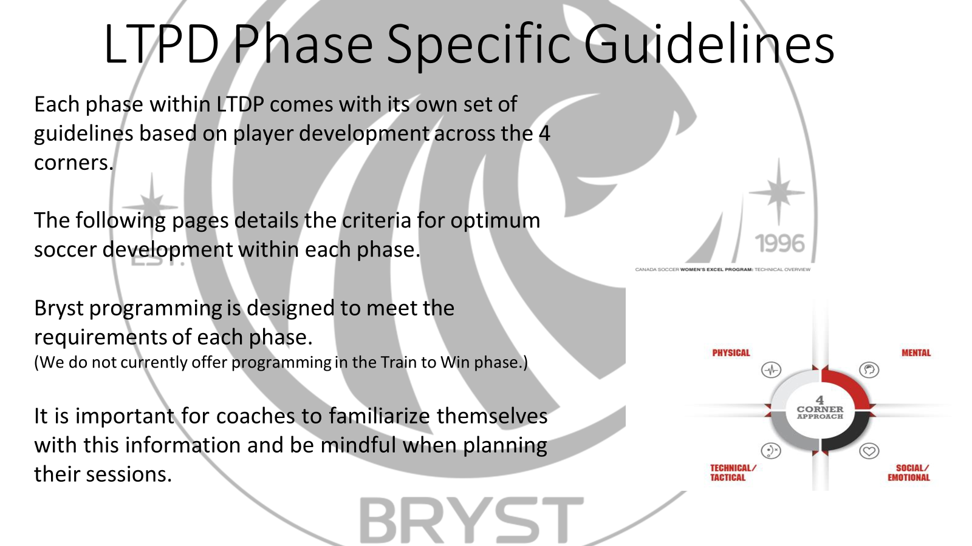

Slide 2

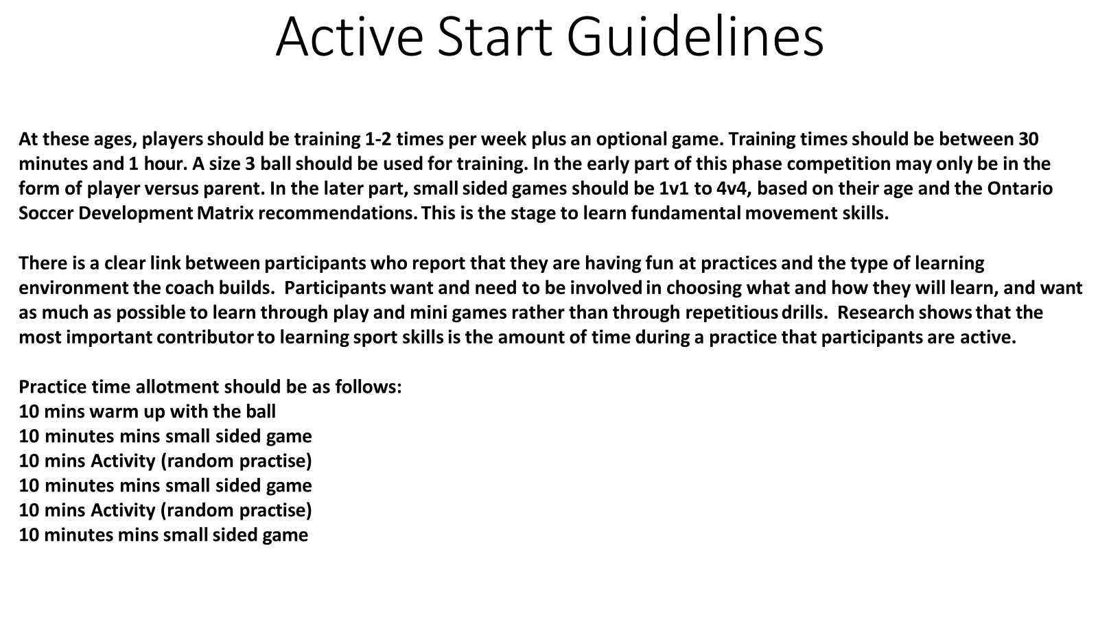

Slide 3
Psychological
Make choices to solve problems
Introduce concept of team versus team games
Concentration and focus on a task
Have players provide input
Confidence
Technical Development
Introduce ball manipulation techniques
Ball Mastery:
  Dribbling and manipulating the ball with both feet ie. Coerver method. Imagination and creativity is vital.
  Controlling the ball on the ground with both feet and different surfaces.
  Control – Look - Play
  Ball juggling.
Progression With the Ball:
  Shielding the ball.
  Turning with the ball
  Feints and change of direction
  Running with the ball
Transmission of the Ball:
  Passing with a partner using inside and outside of feet, up to 3 versus 1
Shooting:
  Shooting with both feet
  Introduce chip, bent shot, volley
  Turning and shooting
  Scoring goals on nets (fun aspect and freedom of expression)
  Focus on the accuracy of the shot
Defending:
  Introduce 1v1 defending
  Introduce pressure on an opponent and closing space
  Introduce challenging for the ball
  Introduce jockeying
  Introduce the concept of goal-side
  Introduce watching the ball and the opponent
  Introduce when to intercept the ball
  Introduce individual marking around the goal area
Social/ Emotional
Cooperation with others
Receive positive reinforcement
Following basic rules
Accepting loss
Listening to coach
Making new friends
Having Fun!
Active Start Phase Areas of
Focus
Physical Development
Basic Movements –Running Jumping, Hopping, Skipping
Basic motor skills
Agility
Balance
Co-ordination of simple movements,

Slide 4
Fundamentals Guidelines
At these ages, players should be training 2-3 times per week plus one game. A size 3 or lighter size 4 ball for U8-U9, size 4 or lighter size 5 ball for U10, or futsal ball should be used for training. Competition games should be 4-aside to 7-aside, based on their age and the Ontario Soccer Development Matrix recommendations. The total number of games in an outdoor season should be 16-20. This is the learning stage and football is for fun. It takes ten years of extensive training to excel in any sport. All of these key factors relate to field players and goalkeepers.
Coaches at this level should be very enthusiastic and promote the fun/passion aspect of the game to the players. They must understand children and be able to influence the players. They must join in the training sessions to motivate the young players. Do not start position specialization as it creates emotional stress and affects physical development. Rotate the players around in various positions. Begin teaching the technical elements of the game and play lots of small games with technical conditions, due to short attention spans. Have players master the ball and do not play one-touch soccer due to limited contacts on the ball.
Practice time allotment should be as follows:
15-20 mins warm up with the ball
15-20 mins small sided game
15-25 mins Activity (random practise) 20-25 Mins Game 3v3 to 4v4

Slide 5
Goalkeeping
Goalkeepers fielding and handling the ball
Introduce distribution with hands and feet
Develop footwork and agility
Develop the stance
Introduce the side dive
Introduce diving at the feet of an attacker
Develop the ability to take a goalkick
Introduce the goalkeeper supporting the defence
Introduce the sweeper-keeper role
Develop communication skills with
teammates
Introduce positioning in and around the goal area
Introduce positioning and communication on set plays
Tactical Development
1 versus 1 attacking a defender and going to goal.
Introduce triangles of support
Introduce creating space for the individual
Introduce combination play
Introduce goal-side in defending
Introduce wing play
Small-sided games with no goalkeepers (3v3, 4v4)
Goalkeepers learning to protect the goal
Training in small-sided games.
Social/ Emotional Development
Provide problem-solving situations on the field
Have different players lead activities
Have players provide input
Receive positive reinforcement
Introduce Leadership skills
Team Bonding Activity
Technical Development
Ball Mastery:
  Dribbling and manipulating the ball with both feet ie. Coerver method. Imagination and creativity is vital.
  Controlling the ball on the ground with both feet and different surfaces.
  Control – Look - Play
  Ball juggling.
Progression With the Ball:
  Shielding the ball.
  Turning with the ball
  Feints and change of direction
  Running with the ball
Transmission of the Ball:
  Passing with a partner using inside and outside of feet, up to 3 versus 1
Shooting:
  Shooting with both feet
  Introduce chip, bent shot, volley
  Turning and shooting
  Scoring goals on nets (fun aspect and freedom of expression)
  Focus on the accuracy of the shot
Defending:
  Introduce 1v1 defending
  Introduce pressure on an opponent and closing space
  Introduce challenging for the ball
  Introduce jockeying
  Introduce the concept of goal-side
  Introduce watching the ball and the opponent
  Introduce when to intercept the ball
  Introduce individual marking around the goal area
Fundamental Phase Areas of Focus
Psychological Development
Introduce relaxation exercises
Introduce positive self talk
Introduce concentration exercises
Introduce goal setting
Introduce imagery and focus during games
Physical Development
Running style (arm movement, leg movement, head position)
Turning, change of direction and agility.
Vertical jump
Basic motor skills (learning to anticipate the ball)
Balance while in control of the ball
Co-ordination while running with the ball

Slide 6
Learn to Train Guidelines
In this phase, players should be training 3 times per week with sessions 90 minutes in length. A size 4 or lighter size 5 soccer or size 5 should be used in training and Games should be 7 a-side or 9-aside, based on their age and the Ontario Soccer Development Matrix recommendations. Introduce offsides in game situations for older players in this phase. The total number of games in an outdoor season should be 16-20. This starts the technical stage where technique must be worked upon daily.
The use of role models is vital at this stage of development. Coaches at this level must be very enthusiastic and sensitive to the athletes. They join in the training sessions to motivate the young players. Encourage decision-making, creativity and emphasize discipline. Players should enjoy co-operative play (working in pairs) and learning how to play. The players at this age must be high on; order, discipline, spirit, communication, creativeness, aggression, vision and passion for the game. Pre- puberty growth in girls can start early during this phase. Pre-puberty growth will start with boys at age 11 and finish at age 15.
Practice time allotment should be as follows: 15 mins warm up with the ball
15-20 mins small sided game
25 mins Activity (Random rather than Block practise) 25 Mins Game 5v5- 7v7

Slide 7
Goalkeeping
Develop the decision making on what ball distribution to use
Develop the goalkeeper supporting the defence with verbal instructions and positioning
Develop goalkeeper stance
Develop footwork with agility and coordination
Develop sideways dive
Introduce deflecting ball
Introduce punching the ball with two fists
Develop diving at feet of attacker
Introduce sweeper/keeper role and reading space behind defenders
Develop all aspects of distribution
Develop role of goalkeeper on set plays
Develop build up from the back and counter attack through the goalkeeper
Develop goal-kick technique
Tactical Development
1 versus 1 skill in attack and defence
Providing support for teammates in small-
sided games (4v4, 6v6)
3v3 or 4v4 games. Understanding triangular play
Develop wing play
Introduce crosses on the ground. Introduce runs into the box
Introduce penetrating runs
Introduce link up from back to front
Introduce switching the play
Overloading one team in small-sided
games to work on a specific aspect ie. keep possession
Develop compact team play
Start to show positional play and positional interchange
Work with the players on finding solutions
on the field and encourage risk-taking
Technical Development
1. Ball Mastery:
Encourage risk-taking with the dribbling skills (Coerver moves
unopposed and then 1v1).
Shielding the ball
Ball juggling.
Players must get a minimum of 1000 touches on the ball per session.
Turning with ball
2.
Progression With The Ball:
Control, Look, Play
Running with ball over distance
Decision making on running with ball or beating opponent
3.
Transmission Of The Ball:
Passing the ball along the ground with teammates (two-touch and one- touch)
Receiving the ball along the ground from teammates (first touch)
Use different surfaces for passing
Introduce combination plays
Introduce wing play
Social/ Emotional
Provide positive reinforcement and timely
assessments
Introduce discipline and structure
Encourage input and decision making from players
Team Bonding Activity
Develop Leadership skills
4.
Shooting:
Shooting the ball on net (individual and combination play).
Creating the attitude to shoot and the preparation to strike the ball
Volleying technique
Develop shooting skills over a longer distance
Read the goalkeeper position before shooting
Develop the selection of shots when going to goal
Learn to Train Phase Areas of Focus
5.
Defending:
Challenge the attacker from different angles
Develop getting goal-side when ball possession is lost
Develop the split vision of ball and attacker
Develop decision making process of when to intercept ball
Introduce a second defender as cover
Defending using man-to-man marking
Develop individual marking close to goal
Develop blocking cross or shot near own goal
Psychological Development
Increase self confidence
Develop leadership
Develop relaxation exercises
Develop positive self talk
Develop concentration exercises
Develop goal setting
Develop imagery and focus during games
Physical Development
Changing direction in relation to a player and a ball
Running backwards and turning to track a ball
Start to develop speed and mobility with linear, lateral and multi-directional movement
Develop endurance through soccer activities
Agility
Balance
Develop strength through own-body weight exercises

Slide 8
Training to Train Guidelines
In this phase, players should be training 4-5 times per week plus one game. Sessions should be 1.5 - 2 hours in length. Games should be 11-aside. The total number of out door games in a season should be 20-25. This is the technical stage with consistent technical work. Players must be technically proficient and displaying creativity.
Coaches should have a strong personality and be very knowledgeable about the game. They should be patient but demanding. Athletes that are experiencing puberty go through growth spurts that can affect their development. Each player must be dealt with as an individual. The players at this age must be high on; discipline, spirit, communication, creativeness, aggression, vision and a passion for the game. They must show courtesy and respect for others, but take responsibility for their own actions.
The recommended practice time allotment is as follows: 15 mins warm up with the ball
15-20mins small sided game
25 mins Activity (Functional or Phase of Play)
25 Mins Game 7v7 or 8v8

Slide 9
Training to Train Phase Areas of Focus
Technical Development
1.
Ball Mastery:
Defending:
Develop jockeying, delay and when to challenge Develop challenging from different angles Introduce ball recovery with body between ball and opponent
Introduce defensive headers and clearing the ball (no heading for u13s)
  Introduce and develop understanding of zonal defense
  Refine split vision of ball and opponent
  Develop understanding of team compactness
  Develop decision on when and how to intercept the ball
  Introduce proper distances between defending unit
  Introduce high, medium and low pressure
  Introduce the offside trap
  Develop last line dropping on vertical play
  Introduce recovery runs
  Educate players on switching from zonal to man to man in the box
  Refine ways of blocking crosses and shots
  Introduce re-positioning if counter attack is played
  Introduce pressure to pressurize a counter attack
Repetition of skills on a daily routine (dribbling- •
Coerver, juggling, shooting, heading, passing, crossing,•
Tactical Development
Small-sided games using 4 versus 4 up to 8 versus 8 (do not play with limited touches)
Winning 1 versus 1 match-ups and working towards a goal
Working in small groups (creating space and movement off of the ball, like the wall pass and the overlap run)
Small-sided games showing team shape (support near and far) plus overloading games (4v1, 5v2)
Positional play and understanding the distances between players and their roles
Introduce systems of play moving from 9-aside to 11-
aside
Develop flank play with crosses on the ground and in the air
Develop central plays and penetrating runs with link ups
Introduce the switching of the play
Develop decision making of ball into feet or into space
Refine set plays
Using defensive delay (track and cover), pressuring and channelling in small-sided games
Team building using the 4 functional lines (goalkeeper, defenders, midfielders, strikers)
Review the choices that players are making in the small-sided games. Decision-making under pressure and in reduced spaces. Use a neutral player to emphasize looking for an open teammate.
volleying and defending). •
Learning the basic skills under pressure from an opponent (1 vs. 1, 2 vs. 2 and 5 vs. 5 and going to goal • with a goalkeeper).
Using both feet at all times.
2. Progression with the ball:
Refine the running and dribbling with the ball and where on the field to use this skill
Refine change of pace with the ball
Work on position specialization
3. Transmission of the ball:
The technique of heading the ball with power
Controlling the ball that travels in the air (first touch)
and the lofted pass
Increase passing range to 30-35 metres
Develop combination plays
Continue to develop wing play
4. Shooting:
Shoot with a variety of surfaces
Shoot from a variety of distances
Shoot from a variety of angles to goal
Refine the shooting accuracy
Refine decision making in front of goal
Refine understanding of following up shot on goal
Refine the sequence of dribbling and shooting
Refine choice and accuracy of shot

Slide 10
Social/ Emotional
Use team captains as leaders
Develop interpersonal skills and teamwork
Provide positive reinforcement and timely assessments
Refine discipline and structure
Encourage input and decision making from
players
Introduce coaching, refereeing and role modelling
Team Bonding Activity
Refine Leadership skills
Goalkeeping
Working with the feet, as goalkeepers must be good field players
Refine sta5nce and positioning
Refine footwork
Refine the different dives
Refine ball handling
Refine tackling at the feet of the attacker
Develop reading the space behind the defence
Refine the various methods of distribution
Progressive training to avoid fear of diving or fear of the ball
Develop communication with team using certain key words
Refine role of goalkeeper on defending at set
plays
Develop decision making on starting the attack
Refine technique for goal-kicks
Training to Train Phase
Areas of Focus
Physical Development
Speedwork over 5, 10, 20 metres (4-6 repetitions)
Speedwork with the ball (co-ordination)
Emphasize aerobic development at onset of growth spurt
Agility work
Develop flexibility and mobility
Core strength and resistance training exercises
Reaction work
Monitor diet and hydration
Two plus hours of sleep prior to midnight with an average of 8 hours of sleep per night
Monitor growth every three months
Psychological Development
Develop self talk
Develop concentration exercise
Continue positive reinforcement
Develop mental preparation
Introduce managing distractions
Develop detailed use of goal setting
Develop imagery with self executing perfect
technique and play
Develop parking and re-focusin
Motivate players to work independently away from the field
Introduce career planning
Develop relaxation exercises

Slide 11
Training to Compete Guidelines
In this phase, players should be training 5 or more times per week plus one game. Sessions should be 1.5 - 2 hours in length. Games should be 11-aside. The total number of games in an outdoor season should be 20-25. Teams should be exposed to and tested in local and US showcase events.
Coaches at this level must be charismatic, experienced, knowledgeable, have managerial expertise and a disciplinarian. Coaches must also show respect for the player, promote values such as honesty, sacrifice, solidarity and fair play. The players at this level must be high on; teamwork, game preparation and winning the duels on the field. Late developers must be given opportunities. Look to perfect technique and tactics with enthusiasm. Develop competitiveness and a winning mentality.
The recommended practice allotment time is as follows:
15 mins warm up with the ball 15-20mins small sided game
25 mins Activity (Functional or Phase of Play) 25 Mins Game 8v8- 11v11

Slide 12
Training to Compete Phase Areas of Focus
Technical Development
Ball Mastery:
  Repetition of skills on a daily routine (dribbling-
Defending:
  Develop jockeying, delay and when to challenge Develop challenging from different angles
  Introduce ball recovery with body between ball and opponent
Introduce defensive headers and clearing the ball (no heading for u13s)
  Introduce and develop understanding of zonal defense
  Refine split vision of ball and opponent
  Develop understanding of team compactness
  Develop decision on when and how to intercept the
ball
  Introduce proper distances between defending unit
  Introduce high, medium and low pressure
  Introduce the offside trap
  Develop last line dropping on vertical play
  Introduce recovery runs
  Educate players on switching from zonal to man to
man in the box
  Refine ways of blocking crosses and shots
  Introduce re-positioning if counter attack is played
  Introduce pressure to pressurize a counter attack
Coerver, juggling, shooting, heading, passing, crossing,•
Tactical Development
Using the wall pass in attack under pressure (combination plays)
Building up the attack from central and wide positions with runs into the box
Team building using the 4 functional lines
Perfect switching the play
Perfect penetrating passes and overlap runs
Refine wing play
Refine creating space
Use defenders in overlapping situations
Refine set plays
Team tactics using 8 vs. 3, 6 vs. 5 and 5 vs. 5 (combined play and creating space)
Zonal marking in defending with proper spacing between players
Re-possessing the ball as a team (team defending)
Refine team compactness
Perfect high pressure, medium pressure and low pressure as a team
Refine recovery runs on counter attacks
Perfect pressure on the ball to prevent counter attack
Full-sided work (11 vs. 11) on tactical speed in
attack and in defense
Perfect decision making
High level of competition to test their skills under pressure.
volleying and defending).
Learning the basic skills under pressure from an
opponent (1 vs. 1, 2 vs. 2 and 5 vs. 5 and going to goal •
with a goalkeeper).
Using both feet at all times.
2. Progression with the ball:
Refine the running and dribbling with the ball and where on the field to use this skill
Refine change of pace with the ball
Work on position specialization
3. Transmission of the ball:
The technique of heading the ball with power
Controlling the ball that travels in the air (first touch) and the lofted pass
Increase passing range to 30-35 metres
Develop combination plays
Continue to develop wing play
4. Shooting:
Shoot with a variety of surfaces
Shoot from a variety of distances
Shoot from a variety of angles to goal
Refine the shooting accuracy
Refine decision making in front of goal
Refine understanding of following up shot on goal
Refine the sequence of dribbling and shooting
Refine choice and accuracy of shot

Slide 13
Goalkeeping
Perfect positioning
Perfect footwork
Perfect all dives
Perfect handling of balls from all heights and
angles
Perfect diving at feet of opponent
Refine reading of space behind defenders
Refine handling of crossed balls
Refine distribution
Refine courage, confidence and concentration
Refine interaction between goalkeeper and teammates
Refine the decision making on set plays
Perfect the goal-kick
Psychological Development
Refine relaxation and anxiety control
Refine self-talk
Take responsibility for decision making
Refine mental preparation
Manage distractions
Refine goal setting
Refine imagery
Training targets are set within competitive games
Physical Development
Vertical jump (power and strength)
Aerobic base (beep test)
Acceleration and speed (40 meter test with sensors every 5 meters)
Springing and bounding (Italian Bosco Test)
Strength and conditioning with individual plan
Maintain and improve fitness and recovery
Highly individualized programs based on position specialization
Monitor flexibility
Monitor diet, hydration and sleep habits
Speed and explosiveness with ball.
Educate players on injury prevention and recovery
Training to Compete Phase
Areas of Focus
Social/ Emotional
Individual feedback
Refine interpersonal skills and teamwork
Refine discipline and structure
Sports Personality Test
Team spirit, team togetherness and a will to
win is vital
Integrate sport, career and life goals
Provide positive reinforcement and timely assessments
Perfect discipline and structure
Engage with input and decision making from players
Refine Leadership skills
Develop coaching, refereeing and role modelling
Team Bonding Activity

